Slide 1
Performance audit
Police responses to serious crime
Report of the
Auditor-General
No. 7 of 2013–14

Slide 2
Why this audit?
Audit all public entities – Police’s “turn”
Around 500 serious crimes per year
Included on TAO’s Annual Plan of Work
endorsed by Public Accounts Committee
publicly disclosed

Slide 3
Audit objective
“To assess the effectiveness of police —
investigations into serious crime
preparation of prosecution briefs
actions undertaken to reduce the incidence of serious crime”

Slide 4
Audit scope: who, when?
1. Who?: Tasmania Police, input from DPP
2. When?: 2008-09 to 2012-13

Slide 5
How we audited Tasmania Police
Developed audit criteria
Interviewed senior police
Interviewed DPP
Analysed statistics and government reports
Reviewed police files
Reviewed Tasmania Police Manual, independent reports

Slide 6
Background to serious crime
37 types of serious crime in Tasmania
1. Crimes against the person (i.e. murder, manslaughter, assault, rape, robbery)
2. Crimes against property above $50k (i.e. burglary, stealing)

Slide 7
Criterion 1
Police investigations

Slide 8
Criterion 1 - Police Investigations (#1)
Assessed effectiveness through six tests:
Clearance rate compared to other jurisdictions
Clearance rate over time
Cleared cases not going to trial
Uncleared crimes – appropriate attention
Clearance rates – accuracy and consistency
Investigation processes – internal benchmarks

Slide 9
Criterion 1: Police investigations (#2)
Clearance rate
A percentage - total number crimes recorded compared to total ‘cleared’
Clearance definition: court proceedings; unable to proceed; lapsing of offence; offence withdrawn

Slide 10
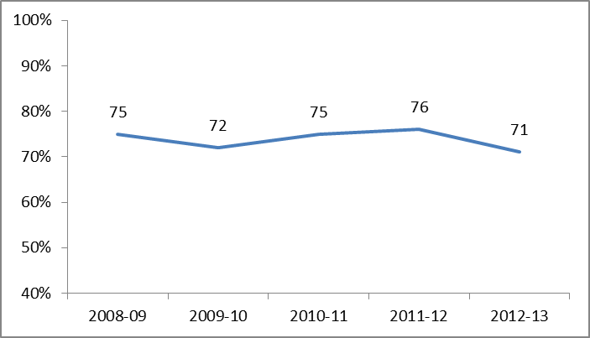
Criterion 1 – Police investigations (#3)
Tasmanian Serious Crime Clearance Rate

Slide 11
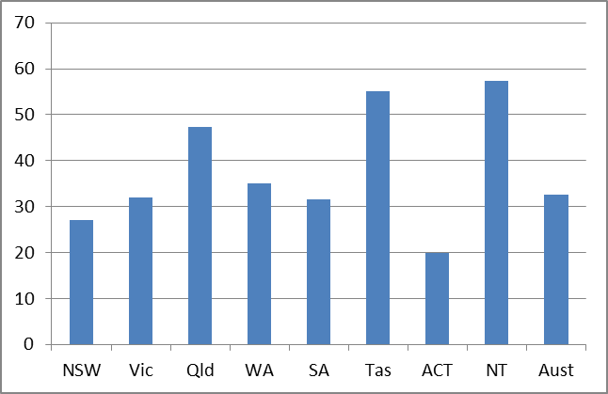
Criterion 1 – Police investigations (#4)
Robbery percentage finalised after 30 days

Slide 12
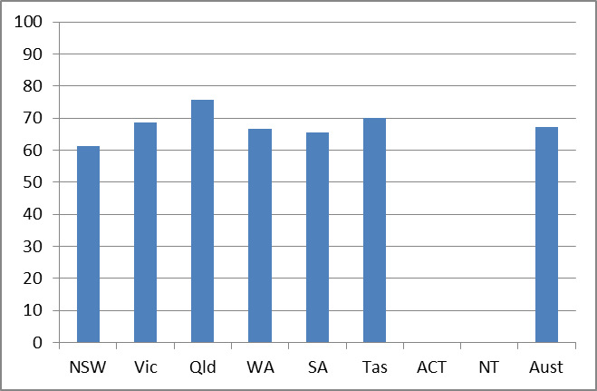
Criterion 1 – Police investigations (#5)
Homicide percentage finalised after 30 days

Slide 13
Criterion 1: Police investigations (#6)
Cleared cases not going to trial – police mistakes
Police clear cases before going to DPP
DPP may not proceed – low likelihood of conviction, not in the public interest
Assessed whether police had been effective at gathering evidence and following correct procedures
No cases where discharge was due to police errors

Slide 14
Criterion 1: Police investigations (#7)
Uncleared crimes – appropriate attention?
Assessed whether uncleared crimes receive appropriate attention
Majority thoroughly investigated
Variety of investigative techniques used
One arson case – former volunteer firefighter
A problem with the OR, not the investigation

Slide 15
Criterion 1: Police investigations (#8)
Clearance rates – accuracy and consistency
1. Police manual – completion of ORs immediately
Remedied Jan 2012
2. Crimes included in database
All satisfactory
3. Validation process
Remedied Jan 2012

Slide 16
Criterion 1: Police investigations (#9)
Following of own internal processes
Police Manual investigation procedures
Six tests (i.e. sufficient inquiries; inquiries of defences; investigation plan)
All satisfactory, except arson case

Slide 17
Criterion 2
Prosecution briefs

Slide 18
Criterion 2: Prosecution Briefs #1
Preparation of prosecution briefs
Comprise brief, fact form, facts for prosecutor
We applied three tests:
Adequate for purpose
Prepared in a timely manner
Following own internal procedures

Slide 19
Criterion 2: Prosecution Briefs #2
Adequate for purpose
Yes
2. Prepared in a timely manner
Yes

Slide 20
Criterion 2 - Prosecution Briefs #3
3. Follow internal procedures
Detective Inspector check – Police Manual
43 percent of files – letter showing checks
Recommendation 1 – all files be checked and DPP correspondence include statement

Slide 21
Criterion 3
Crime prevention programs

Slide 22
Criterion 3 - Crime prevention (#1)
Prevention can include front-line policing and crime prevention programs
Reviewed effectiveness by asking:
Crime levels compared to other jurisdictions?
Police reduced crimes over time?
Prevention - evidence-based, effective, raised awareness?

Slide 23
Criterion 3 - Crime prevention (#2)
Level of serious crime compared to other jurisdictions
Serious crimes per 100 000 people (2011)

Slide 24
Criterion 3 - Crime prevention (#3)
Had police been effective at reducing the incidence of serious crimes over time?
Causal relationship difficult to determine (NSW Bureau of Crime Statistics and Research)
We analysed two sets of data:
Trends in serious crime
Funding for community support work

Slide 25
Criterion 3 - Crime prevention (#4)
Trends in serious crime
Number of serious crimes 1998-99 to 2012-13

Slide 26
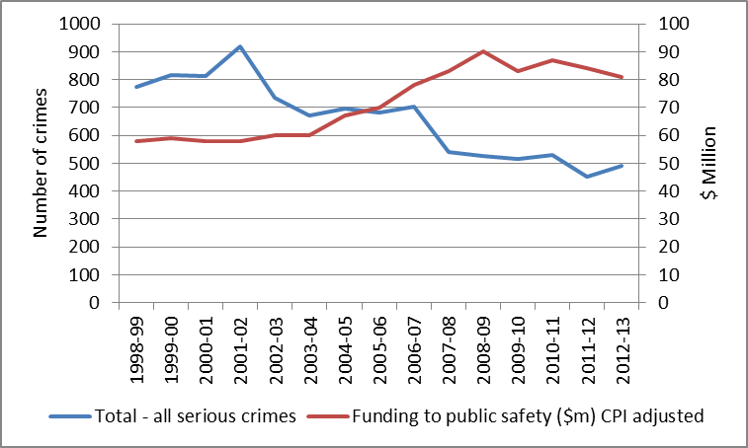
Criterion 3 - Crime prevention (#5)
Public Safety – Support to the Community (includes police patrols and work with community organisations)

Slide 27
Criterion 3 - Crime prevention (#6)
Have programs been evidence based, effective and raised community awareness?
Operation Unification – Firearms
Operation Icarus – Arson at Bridgewater
Inter-Agency Support Teams – youth

Slide 28
Criterion 3 - Crime prevention (#7)
Operation Unification
Illegal firearms – organised crime
Public calls Crime Stoppers – 2 week period
Evidence – Firearms Act 1996
21 calls compared to usual 4
33 firearms seized
17 people charged
Successful, needs performance targets

Slide 29
Criterion 3 - Crime prevention (#8)
Operation Icarus
Bridgewater arson prevention (5 year program)
Focus on Housing Tasmania Properties
Signs, patrols, surveillance cameras, bail checks
No research or evidence
No success in raising community awareness
Needs performance targets

Slide 30
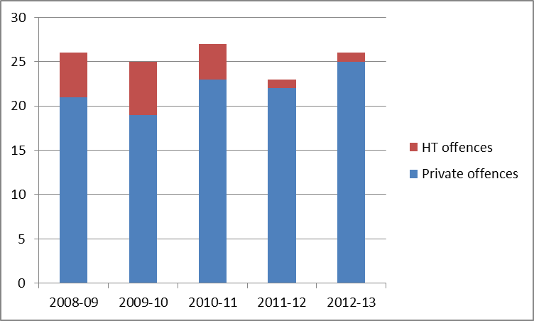
Criterion 3 - Crime prevention (#9)
Arson offences against private and HT properties

Slide 31
Criterion 3 - Crime prevention (#10)
Inter-Agency Support Teams
Committees of service providers for youth with two or more of:
Mental health issues
Alcohol/ drug use
Family violence
Accommodation issues
Education problems
Offending

Slide 32
Criterion 3 - Crime prevention (#11)
Inter-Agency Support Teams objectives
Reduction in behaviours that lead to interaction with youth justice system
Enhancement of protective factors that encourage improved behaviour (i.e. regular attendance at school)
More coordinated support for children and families

Slide 33
Criterion 3 - Crime prevention programs #12
Inter-Agency Support Teams success
Evidence – risk factors (i.e. disrupted families, single and teenage parenting) can lead youth to crime
Not designed to improve broader community understanding of youth issues
Better collaboration between agencies

Slide 34
Criterion 3 - Crime prevention programs #13
IASTs – exits by category
57 per cent – stable, no further support
30 per cent – stable, single agency support
11 per cent – not willing to engage
2 per cent – consent withdrawn
Recommendation 2 – performance targets for all substantial prevention programs

Slide 35
Recommendations
1. All files be checked and DPP correspondence include statement
2. Performance measures for all substantial prevention programs
Police have agreed to implement quickly

Slide 36
Follow-up
Revisit recommendations in two years

Slide 37
Current audits
Alcohol, Tobacco and Other Drug Services: five-year plan
Radio communication networks
Security of Information and Communications Technology (ICT) infrastructure
Motor vehicle fleet usage and management
Teacher quality in high schools
Quality of Metro services
Follow-up audit – October 2009 to September 2011

Slide 38
Thanks for your attendance! Any further questions?

